Slide 1

School of Computer Engineering and Technology
Food Ordering System for Multiple Restaurants
Guided by
Dr. Shitalkumar Jain
Students Name:
Harshal Tawade (04)
Abhishek Hajare (15)
Lalit Kinage (10)

Slide 2
Index
Introduction
Problem Statement
Objectives
Proposed Block Diagram
Methodolgy
Functional Requirements
Non-Functional Requirements
Entity Relationship Diagram
Use Case Diagram
Activity Diagram
Sequence Diagram
Software and Hardware Requirements
Implementation
References

Slide 3
Introduction
In todays age, many restaurants focuses on enhancing speed and quality of service. Until recently , many of these food orders are placed over the phone but there are many disadvantages to this system such as inconvenience of customer need to have physical copy of menu, lack of visual confirmation that the order was placed correctly and restaurants needs employee to answer phone call for taking orders. This requires restaurants to hire more employees. This process is more time consuming and make services of restaurants slow

Slide 4

Motivation
Like other industries, food industries has also changed with rise of digitization. The restaurants needs to stay updated about what is happening in the market. An online food ordering evolved tremendously with the rise of digitization .Also after the pandemic online food ordering has gain popularity as it being a contactless service, removing physical menus.
The safety, security and satisfaction of customers are now main focus for restaurants. Many new restaurants are entering into the market. So to sustain in competitive market restaurants are moving to online platforms.

Slide 5
Problem statement
To make Online Food Ordering System for Multiple Restaurants
A website that allows customer to easily order the food without waiting in long queues and wasting time. Restaurants can expand their business and save money spend on employees and time to take orders.

Slide 6
Objectives
Ordering Food Anytime
Find nearby restaurants
Order food from remote location
Provide online menu information to customer
Increase sales and revenue by knowing the special offers
To make food ordering easy and convenient to customer
Reduce Time wastage by elimination long queues
Reduce monthly cost to pay employees
Analyze Orders of Restaurant

Slide 7
Features
Simple , fast and convenient Ordering of food
Online Menus with Food Description
Remote Access
Order Notification
User Friendly Interface
Search nearby Restaurants
Maintain Order History and Sell report
Repeat or Cancel Order

Slide 8
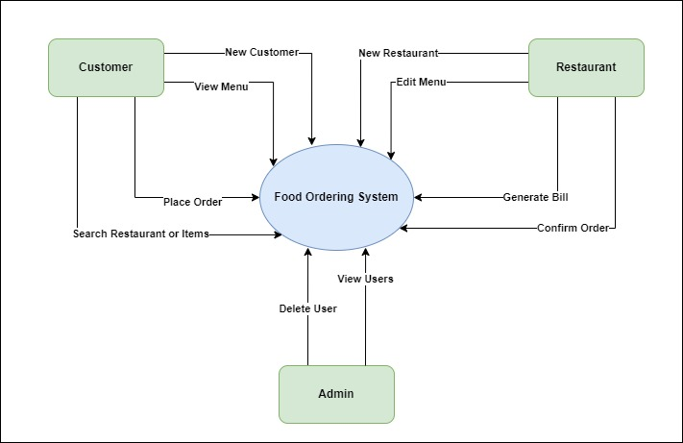
Proposed Block Diagram

Slide 9
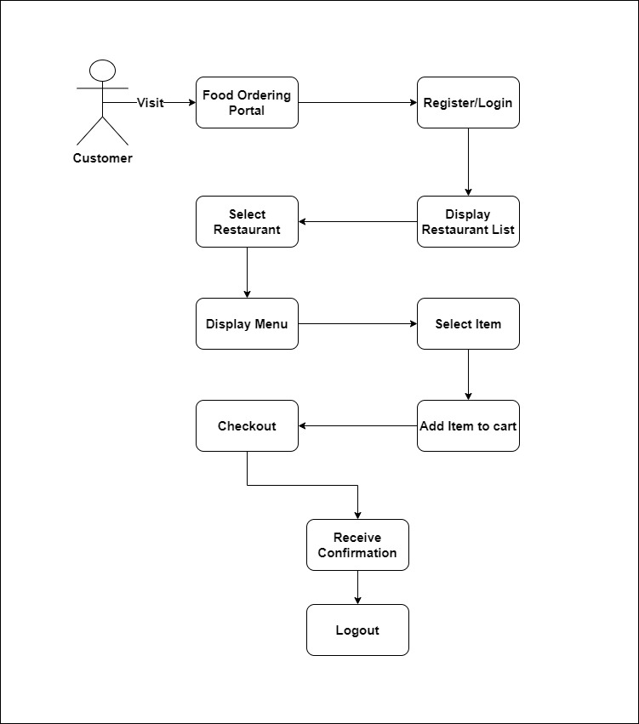
Methodology

Slide 10
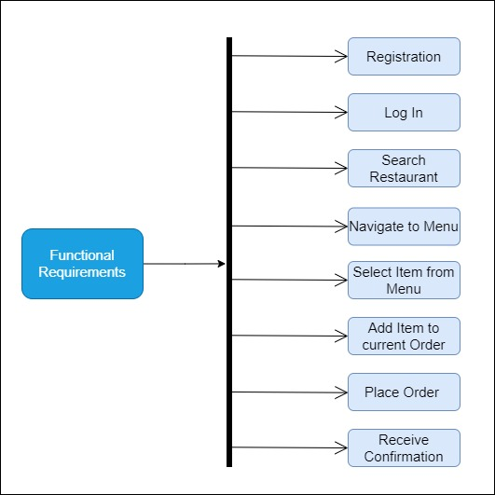
Function Requirements

Slide 11
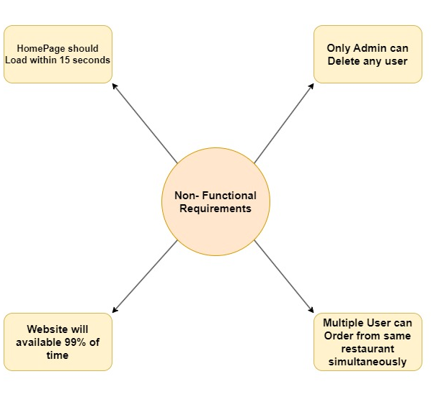
Non-Functional Requirements

Slide 12
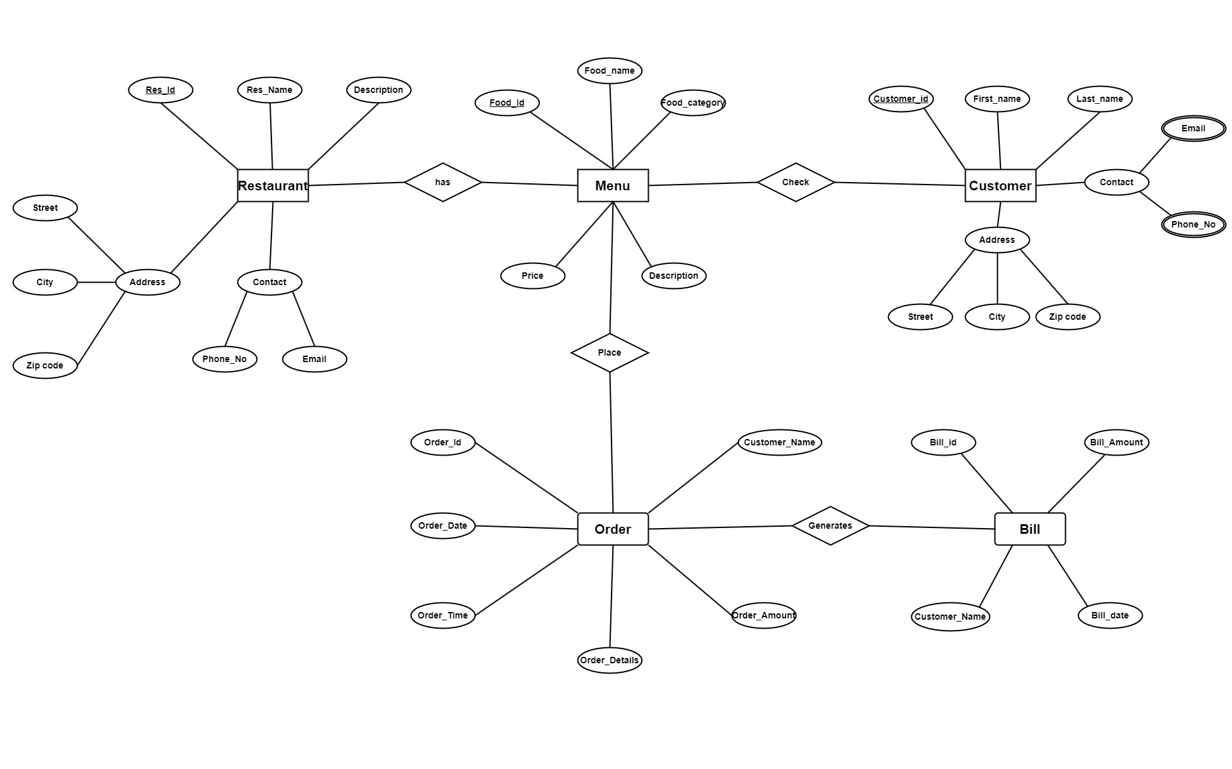
Entity Relationship Diagram

Slide 13
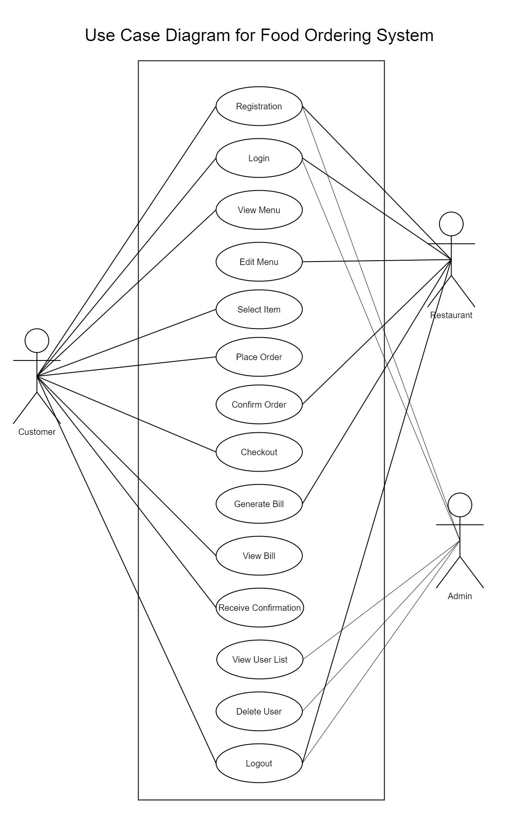
Use Case Diagram

Slide 14
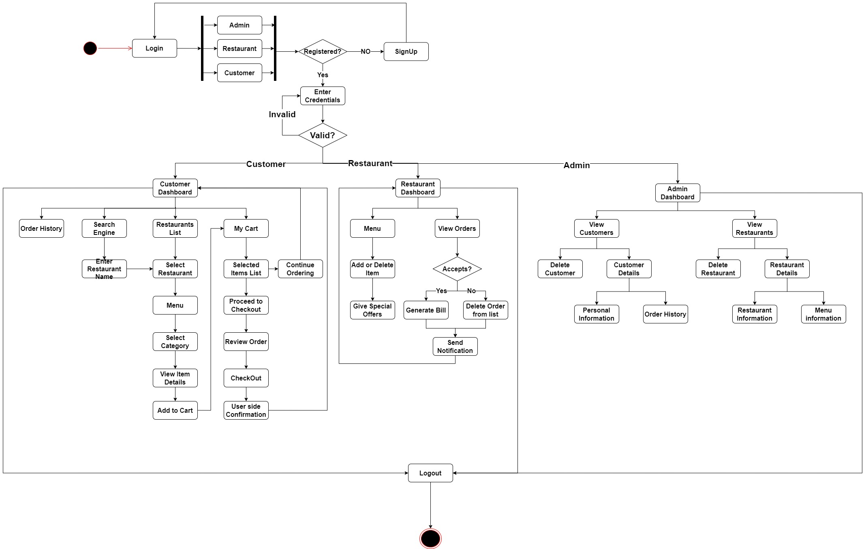
Activity diagram

Slide 15
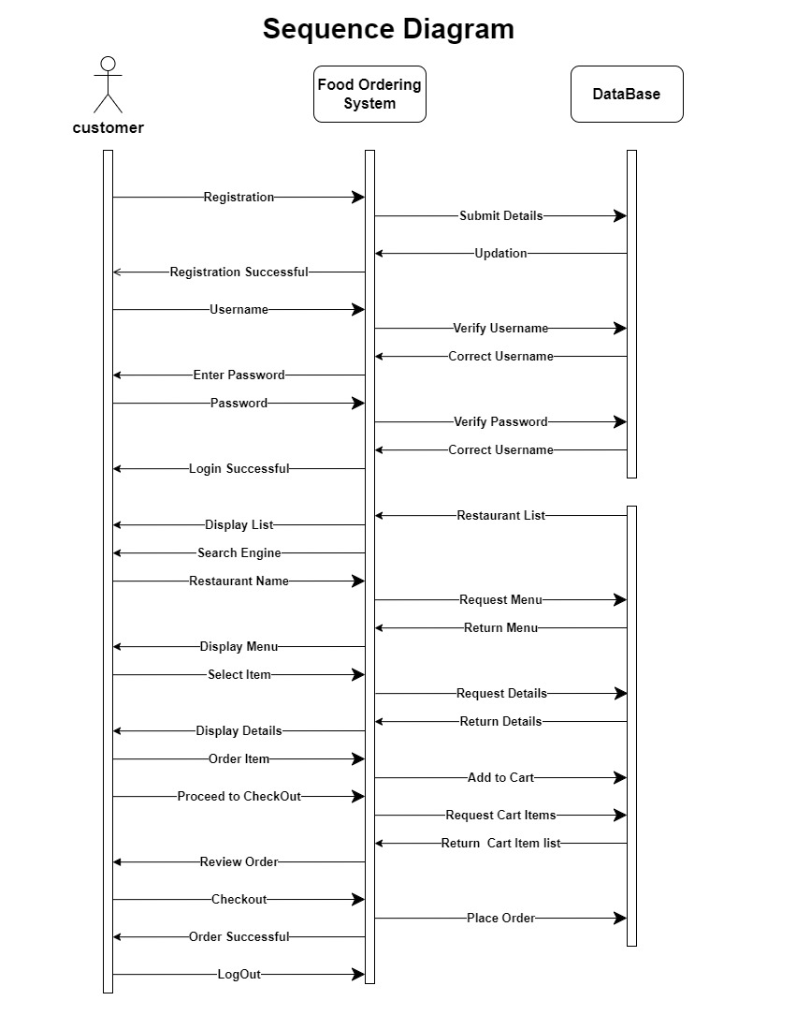
Sequence diagram

Slide 16





Software and Hardware Requirements
Software Requirements:
HTML
CSS
Javascript
PHP
BootStrap
MySQL
Windows XP or above
Internet explorer or any compatible
web browser
Hardware Requirements:
Computer
Internet Facility
Antivirus is recommended

Slide 17
Implementation

Slide 18
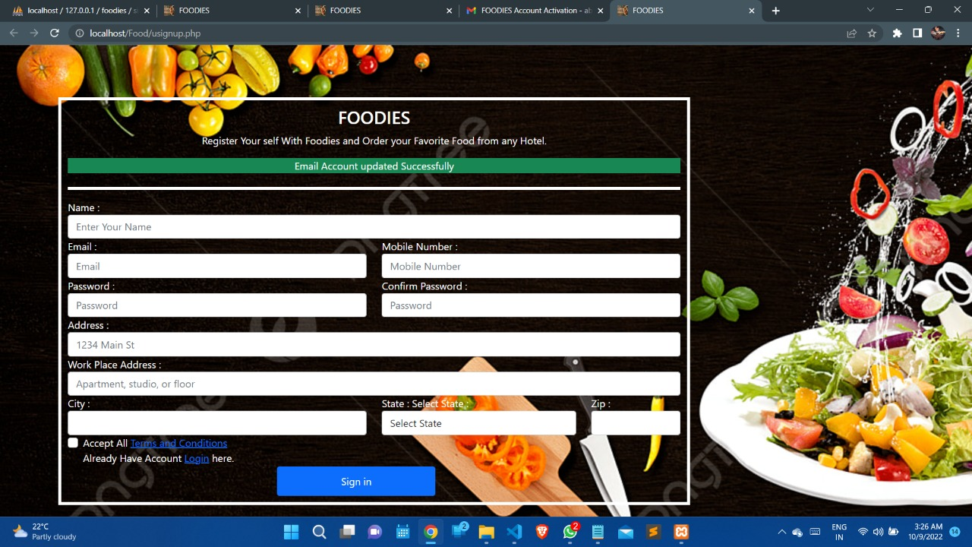
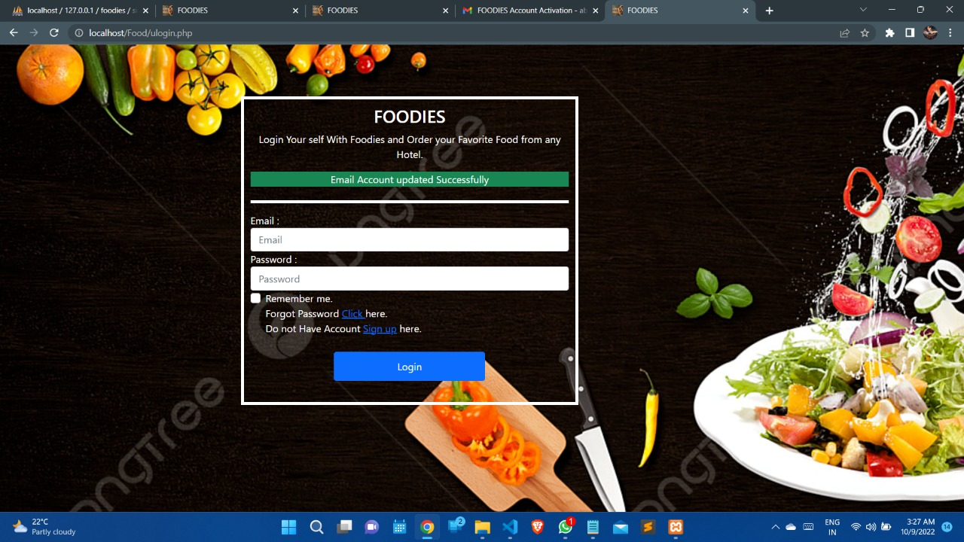
Registration
Login

Slide 19
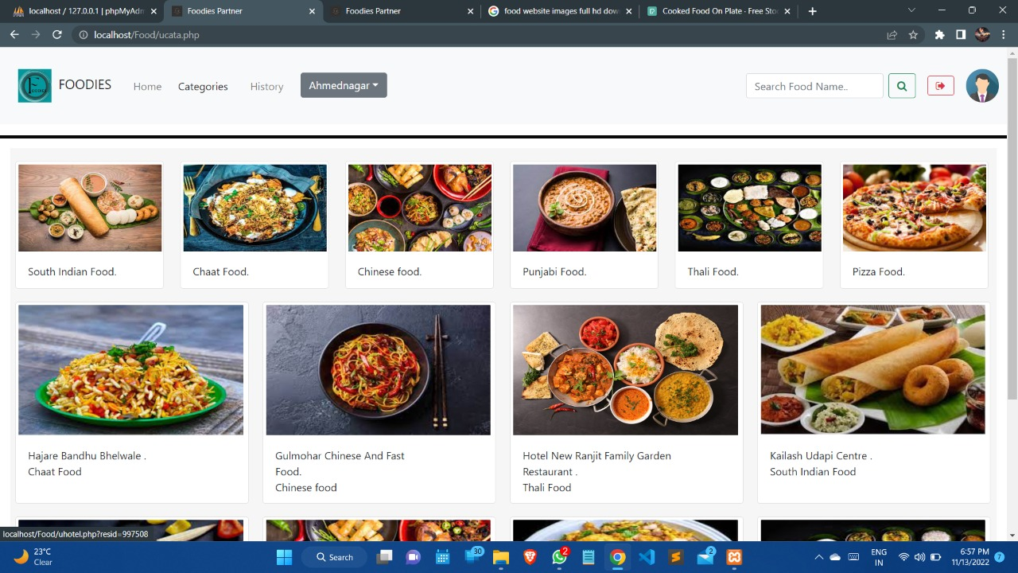
Customer Dashboard

Slide 20
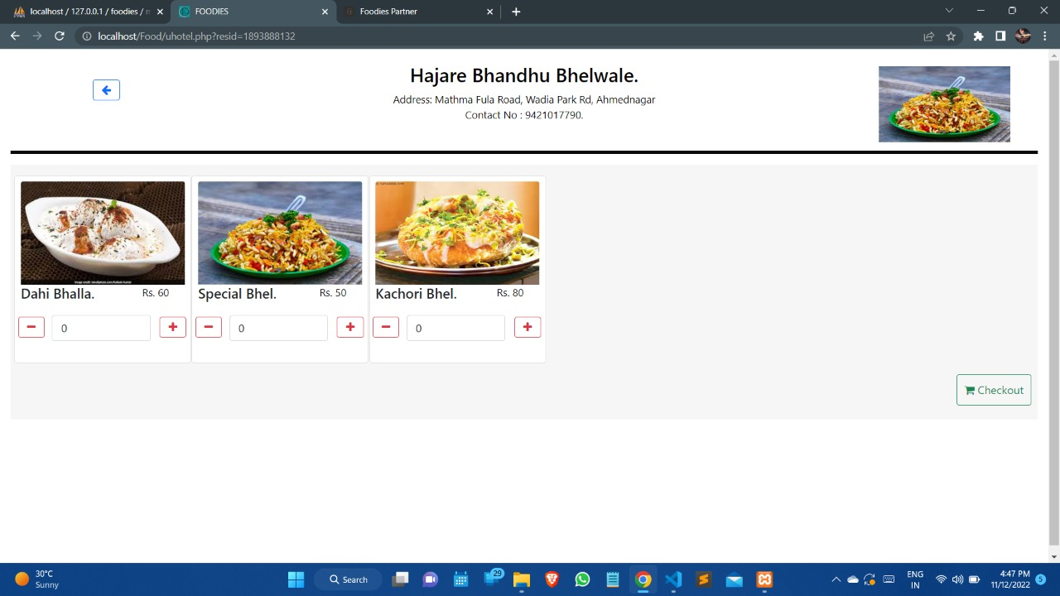
Restaurant Dashboard

Slide 21
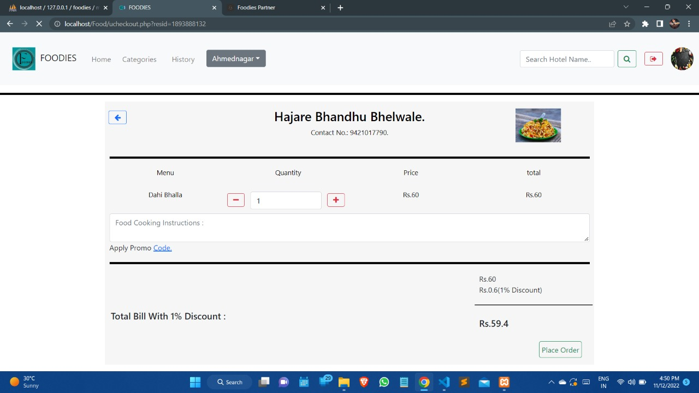
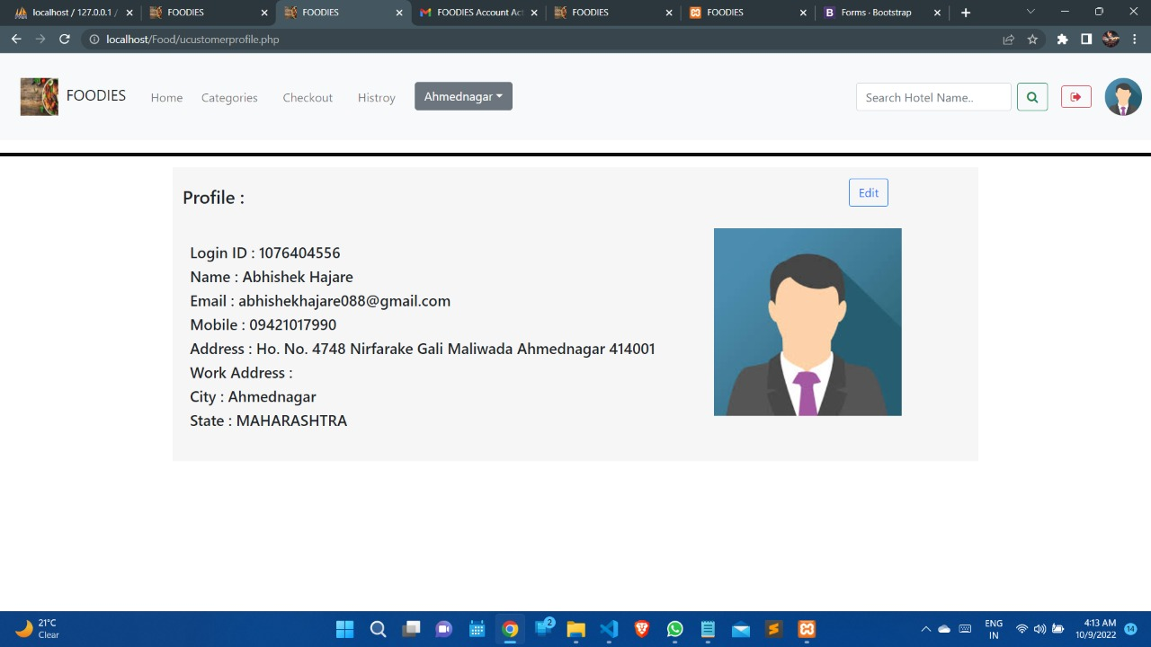
Bill Generation
Customer’s Profile

Slide 22
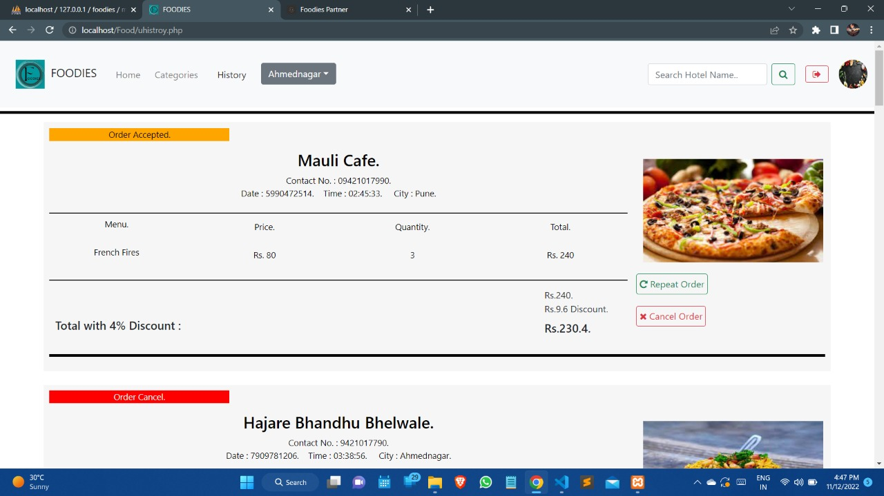
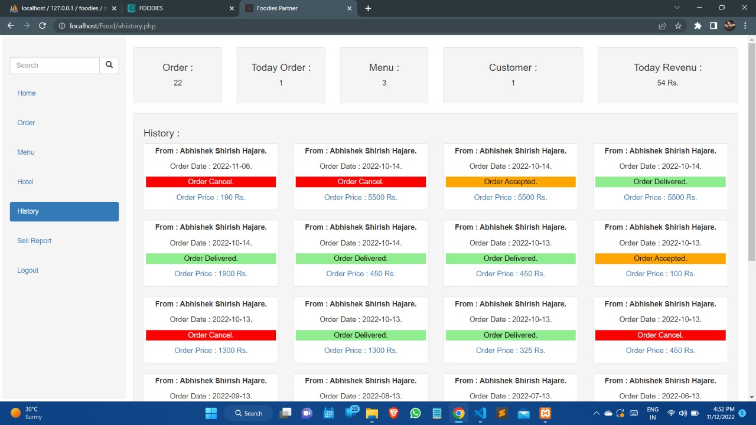
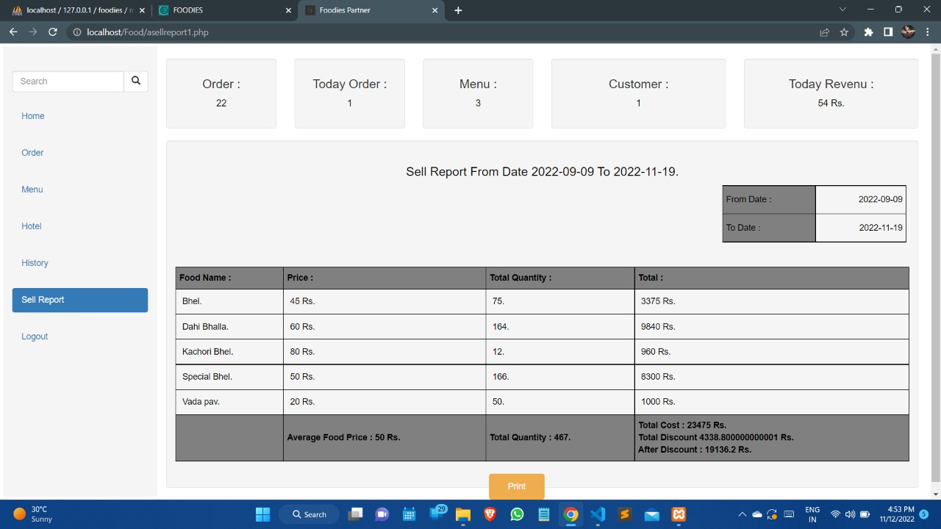
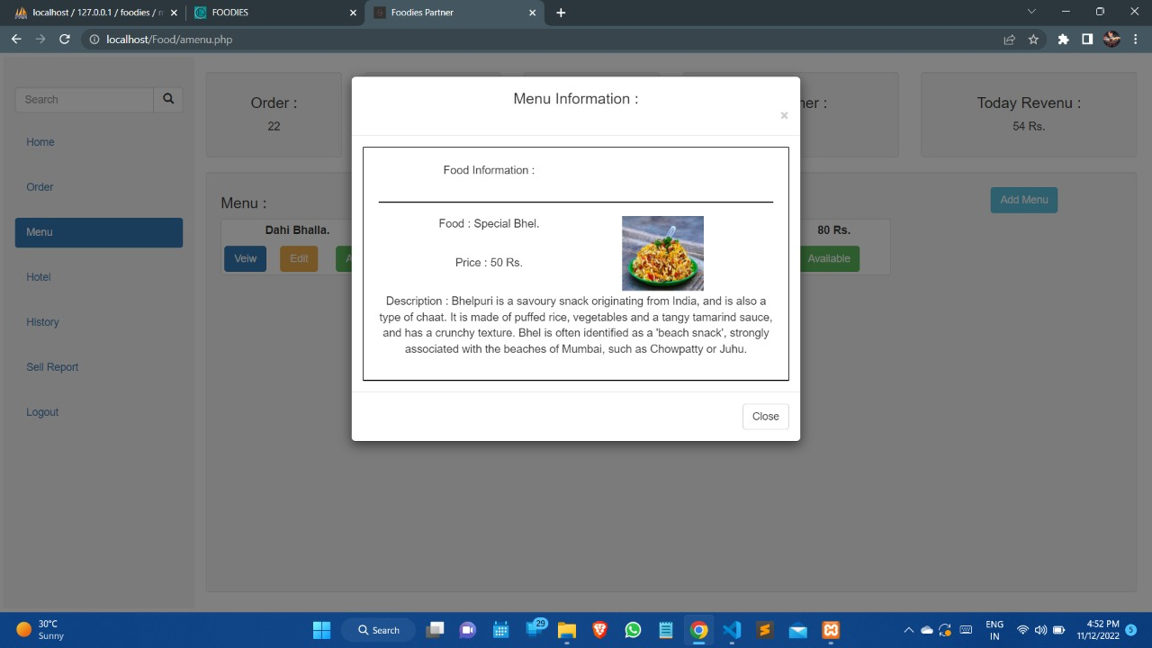
User’s Order History
Restaurant’s Order History
Sell Report
Menu Information

Slide 23
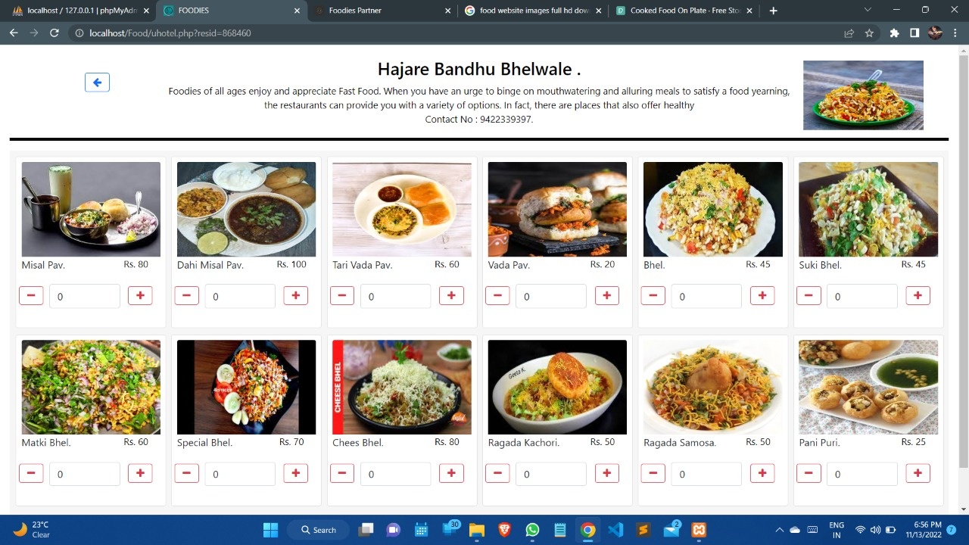
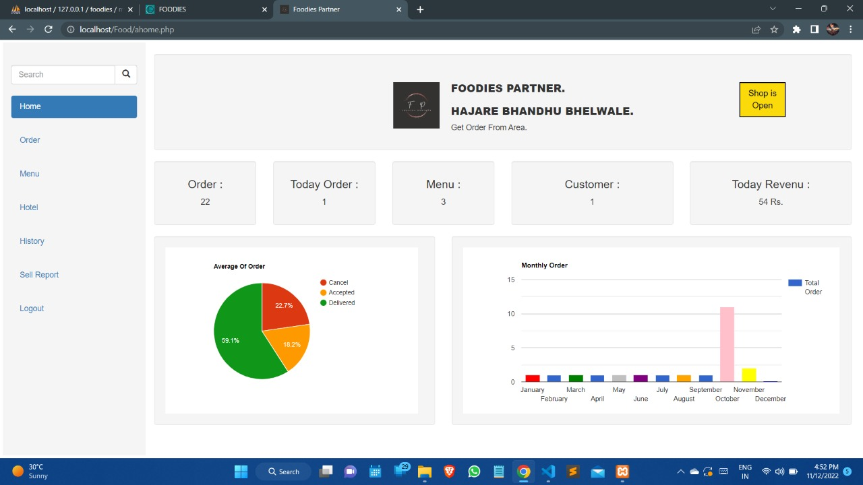
Restaurant Pages
Restaurant Analysis

Slide 24
References
1. De Leon, E. Best Online Food Ordering System. 2008, August 23
Restaurant Checklist.
2. Khairunnisa, K., Ayob J., Mohd. Helmy A. Wahab, M. Erdi Ayob, M. Izwan Ayob & M. Afif Ayob 2009, ‘The application of wireless food ordering system’, MASAUM Journal of
Computing,
3. Purname, J., & Wibowo, A.Y. Wireless Application for Ordering (2007).
Management System in a Restaurant.
4. Nur Hanis Ihsan 2011, ‘Restaurant ordering system using mobile application’. [10 March 2019].
5. IEEE. IEEE Std 830-1998 IEEE Recommended Practice for Software
Requirements Specifications. IEEE Computer Society, 1998.

Slide 25
Thank You!!
Any questions.

